Slide 1

AI-Powered Puerto Rico Travel Planner
By: Jesus D. Hernandez Roman

Slide 2
Project Objectives
Develop a chatbot-based interface that interacts with users to suggest travel destinations.
Implement a machine learning-powered ranking system that recommends locations based on user preferences.
Integrate real-time weather forecasting to enhance travel planning.
Enable users to compile and finalize a visit itinerary dynamically.

Slide 3
Minimum Viable Product (MVP)
The chatbot should interact with users and recommend places based on their interests
Ability to compile a list of places to visit
Maintain a friendly and informative conversation

Slide 4
System Requirements & Enhancements
Implement a chatbot-based interface
Integrate real-time weather data
Suggest itineraries based on user preferences
Future improvements: Maps, itinerary scheduling, hotel & restaurant suggestions

Slide 5
Technologies Used
Programming Language: Python
Machine Learning Model: Sentence Transformer (all-MiniLM-L6-v2)
Vector Search Engine: FAISS
Web Framework: Streamlit
APIs: OpenAI for NLP, OpenWeather for weather forecasts

Slide 6
Data Sources & Processing
Landmarks & Municipalities: Wikipedia data
News Articles: Puerto Rican newspaper El Mundo
Storage & Retrieval: Vector database for semantic search

Slide 7
AI-Powered Search & Ranking
Use of FAISS for fast nearest-neighbor searches
Sentence Transformer embeddings for matching interests to locations
Ranking System: Places are ranked based on user interests

Slide 8
Key Features
AI-driven location recommendations
Interactive travel itinerary building
Real-time weather data integration
Structured and dynamic response system

Slide 9
Implementation & Workflow
User inputs travel date & interests
System searches & ranks locations
User selects locations to visit
System provides additional details (weather, distance, etc.)
Final itinerary is generated

Slide 10
Challenges & Solutions
Handling Missing Data: Ensured data validation before use
Ensuring Fast Recommendations: FAISS optimized for speed
User Interaction Flow: Improved UI responsiveness & chatbot design

Slide 11
Future Enhancements
Real-time hotel & flight booking integration
Itinerary optimization using mapping APIs
Multi-language support for broader accessibility
More detailed location descriptions & images

Slide 12
Evaluation Process
Qualitative Testing: Frequent interaction & logging
Automated Evaluation: LLM-generated ground truth answers
LLM-as-a-Judge: Using AI models to evaluate response accuracy

Slide 13
Deployment Strategy
Cloud-based backend for remote access
AI-powered API endpoints for recommendations
Potential future improvements: Public web interface

Slide 14
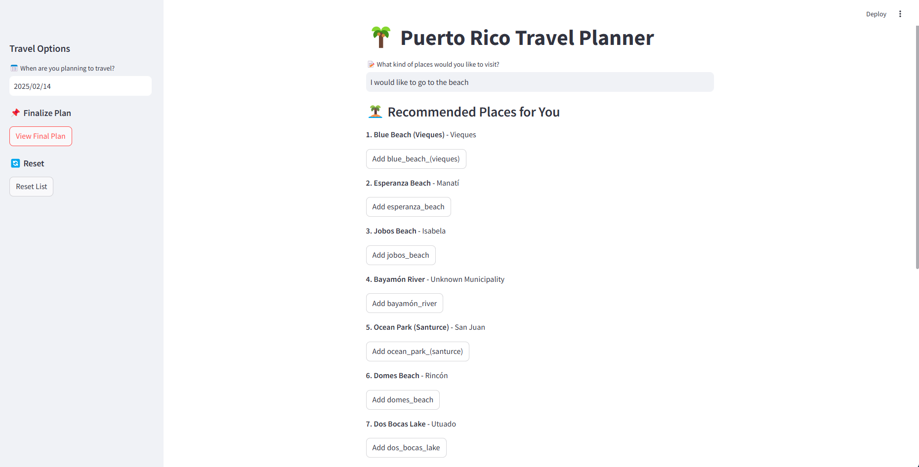
UI Design

Slide 15
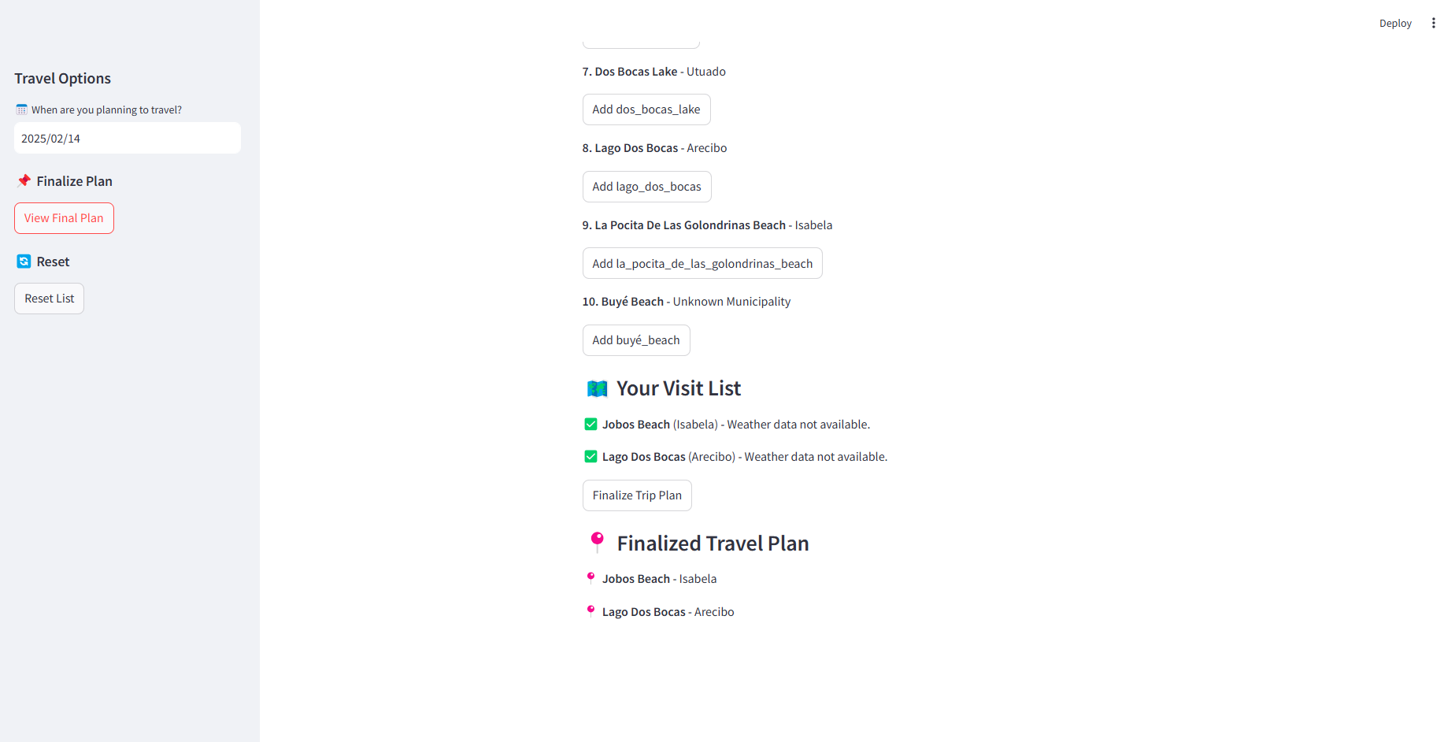
UI Design

Slide 16

Conclusion
AI-powered travel planning enhances user experience
The system provides intelligent & personalized recommendations
Future developments will improve usability & scalability

